Slide 1

Generative AI and prompt engineering
Harsh Dalal

Slide 2
What is Generative AI
AI that can generate text, images, audio, video, code.
Uses LLMs, diffusion models, transformers.
Learns patterns → creates new content.
There's no need for you to learn a language like Java or SQL to accomplish something worthwhile, all you need is to use your language, state what you want and out comes a suggestion from an AI model.

Slide 3
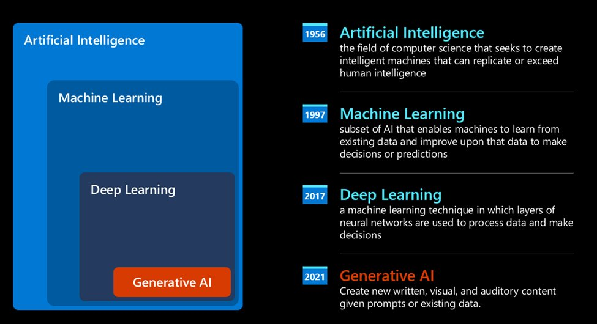
Present day, Generative AI

Slide 4
Why Gen AI is Transformative
Boosts productivity & creativity.
Automates manual tasks.
Helps build copilots, assistants, agents & smart apps.
Accessible to everyone—developers & non-tech users.

Slide 5
What is an LLM (Large Language Model)
Deep neural network trained on massive text corpora.
Understands + generates human-like language.
Backbone of ChatGPT, Gemini, Claude, Llama.
Supports reasoning, summarization, translation, coding.

Slide 6
How LLMs Work
LLM learns patterns, grammar, facts & reasoning from text.
Predicts the next best word in a sequence.
Uses attention mechanism to focus on important context.
More parameters → better reasoning & accuracy.

Slide 7
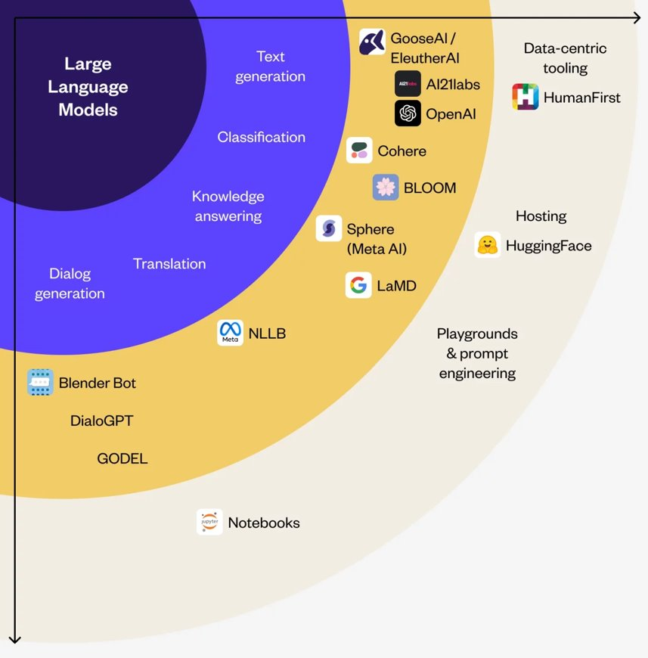
Exploring and comparing Different LLMs​
Audio and speech recognition.
  For this purpose, Whisper-type models are a great choice
Image generation.
  For image generation, DALL-E and Midjourney are two very known choices.
Text generation.
  Most models are trained on text generation, and you have a large variety of choices from GPT-3.5 to GPT-4.
Multi-modality.
  If you're looking to handle multiple types of data in input and output, you might want to look into models like gpt-4 turbo with vision or gpt-4o - the latest releases of OpenAI models

Slide 8
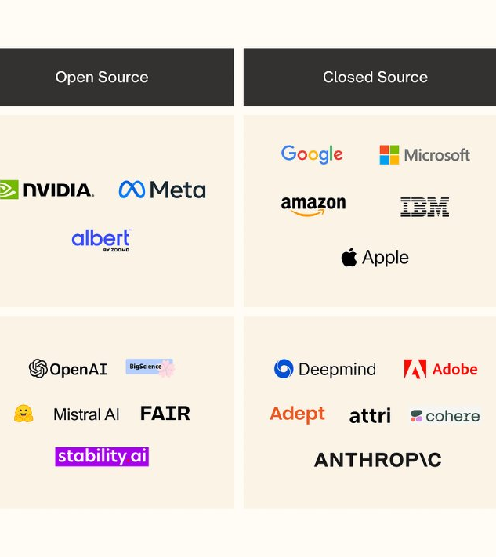
Open-source models
Open-source models are models that are made available to the public and can be used by anyone.
They are often made available by the company that created them, or by the research community.These models are allowed to be inspected, modified, and customized for the various use cases in LLMs.

Slide 9

Proprietary models
Proprietary models are models that are owned by a company and are not made available to the public. These models are often optimized for production use.

Slide 10
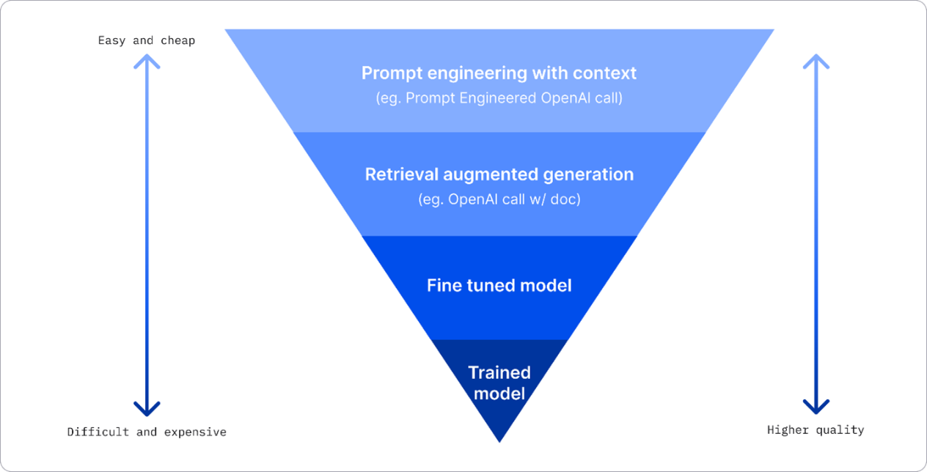
Improving LLM results

Slide 11
What is Prompt Engineering?
The skill of designing effective prompts to control LLM outputs.
Converts user intention → clear instructions for the model.
Improves accuracy, reduces hallucination, enhances consistency.

Slide 12

Example of Prompt Engineering
Generating AI-Assisted Robots >> Prompt: "Design a robot that assists humans in their everyday tasks, enhancing their quality of life."
Creating Abstract Digital Art >> Prompt: "Generate an abstract artwork that evokes a sense of tranquility and wonder."
Designing Futuristic Cityscapes >> Prompt: "Imagine a futuristic cityscape that represents a utopian vision of society."

Slide 13
Importance of Prompt Engineering
Better prompts = better model performance.
Essential for building GenAI apps, agents, automation & copilots.
Reduces iteration time & improves reliability.

Slide 14


Structure of a Good Prompt
Role / Persona
Task / Objective
Context / Background
Constraints / Formatting
Examples (optional)
Output format (table, bullets, JSON)

Slide 15
Example Prompt Structure
Role: Expert Data Analyst
Task: Analyze quarterly sales performance
Context: CSV data with region, revenue, products
Format: Provide insights in bullet points + 1 table
Extras: Keep it short & actionable

Slide 16
Prompt Engineering Techniques
Zero-shot prompting
– No examples; direct question.
Few-shot prompting
– Provide example inputs/outputs to teach format.
Chain-of-Thought (CoT)
– Ask model to “think step-by-step” for reasoning tasks.
Role Prompting / Persona Setting
– Assign expert roles for better control.
Instruction-based prompting
– Clear, specific instructions reduce errors.
Contextual prompting
– Add domain knowledge → more accurate responses.
Refinement / Iterative prompting
– Improve results through multiple prompt revisions.

Slide 17

Limitations of simple prompting
Big topic, you don't know if it's going to be about countries, capitals, rivers and so on.
Format, what if you wanted the questions to be formatted in a certain way?
As you can see, there's a lot to consider when creating prompts.
So far, we've seen a simple prompt example, but generative AI is capable of much more to help people in a variety of roles and industries.

Slide 18

Any question

Slide 19

Thank you

